Slide 1
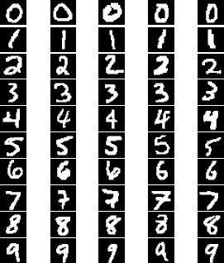

Neural Network for Handwritten Digits Recognition
Li-Yi Lin, Chenyang Su

Slide 2
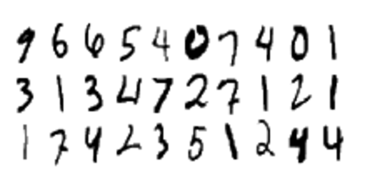
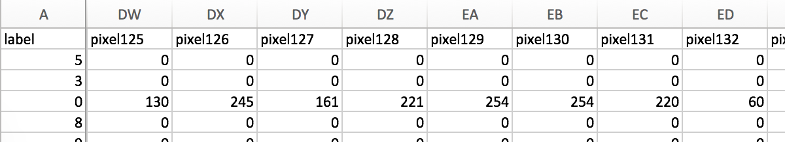
Dataset
Total 28x28 Features

Slide 3
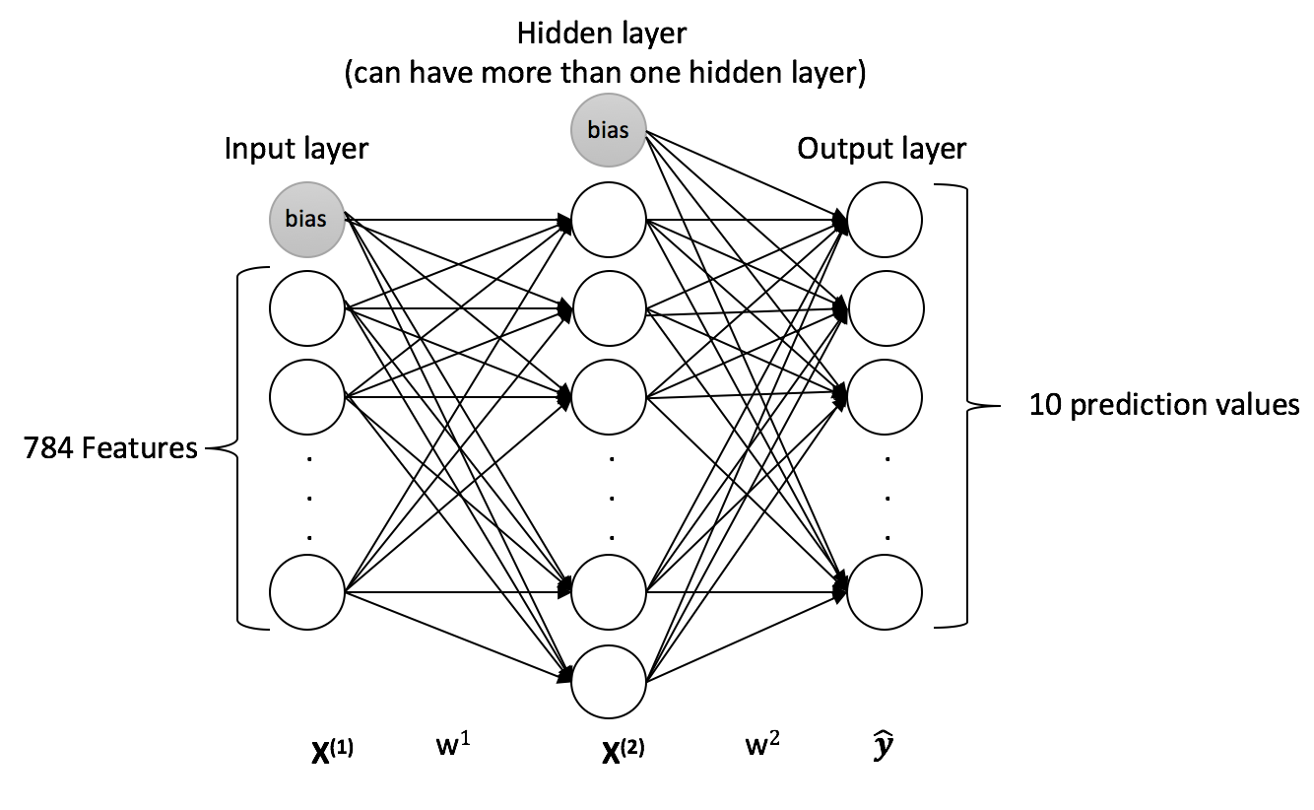
Model & Key Ingredients
Feedforward
Backpropagation
Support arbitrary number of hidden layer and nodes
Support batch and mini-batch update
Feature Scaling

Slide 4
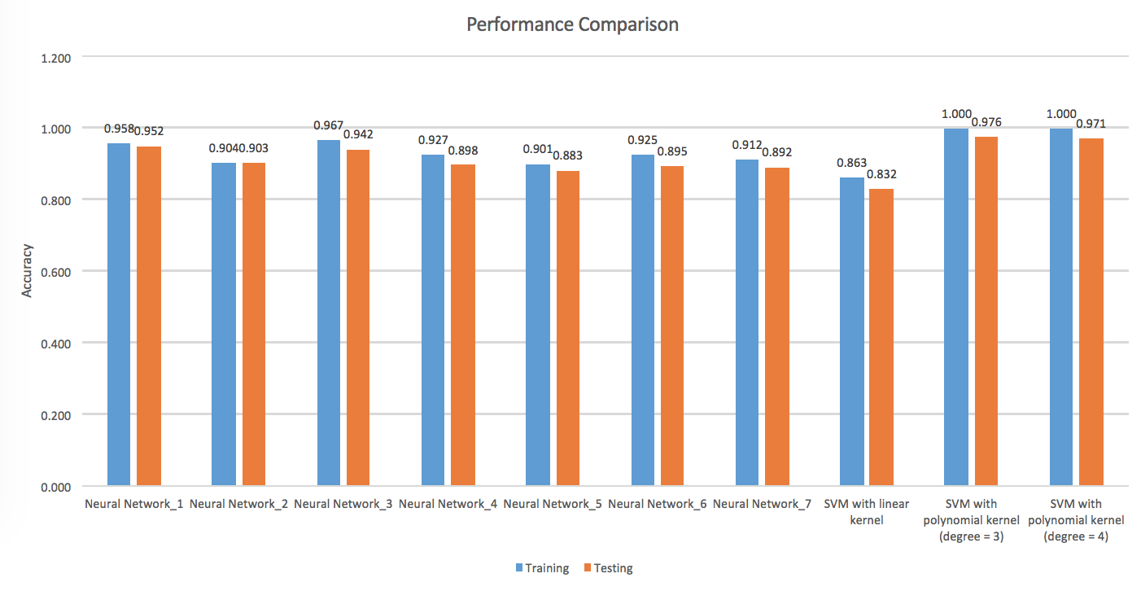
Performance Comparison

Slide 5
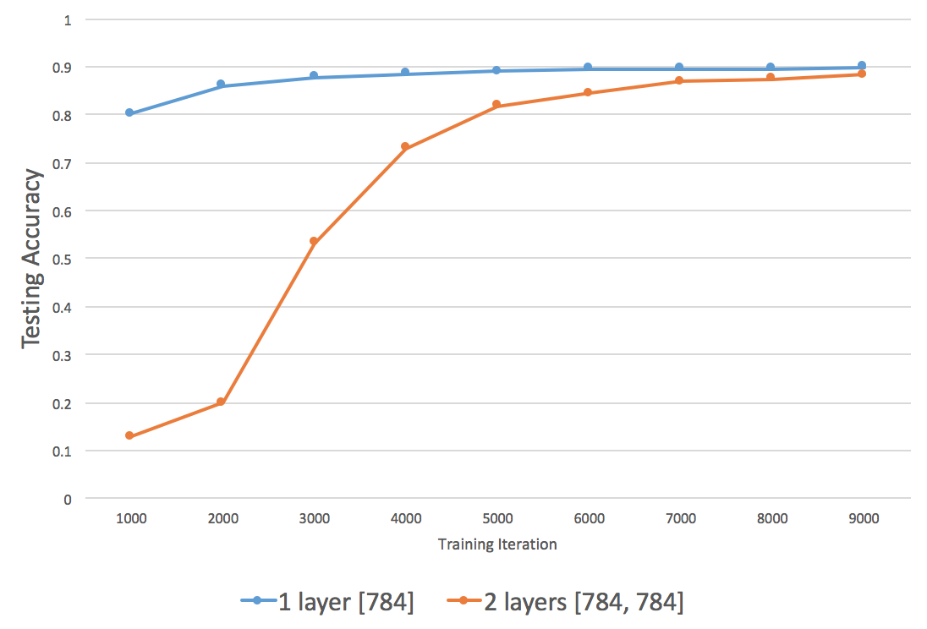
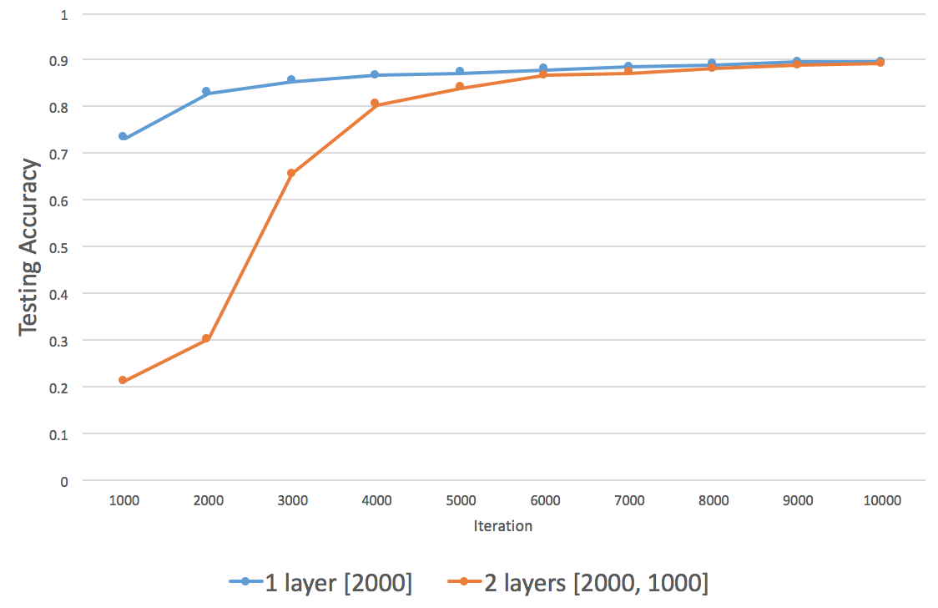
1 layer vs 2 layers

Slide 6
Thank You!

